Slide 1
DOMAIN DRIVEN DESIGN SOFTWARE DESIGN APPROACH
Avinash thorat
DECEMBER 8, 2022

Slide 2
Agenda
DDD -Inception and background
Why use
DDD in Microservice
Aggregate in DDD
1 end to end example of MPM micro service
Must have with DDD
Anti-patterns
Dealing with Database
Conclusion

Slide 3
DDD Inception and background

Slide 4
background
Software design approach focusing on software modelling to match a domain according to the input of domain experts.
Eric Evans – 2003, First published the concept.
Software development with focus primarily on business or whatever our software will be assisting, the domain and not on the technology.
Based on strategic designs.
Strategic design - is the use of design to solve technology, business and customer needs. The focus is also on the future implications, outcomes and a bigger contextualization of the vision of the brand. Perception, conception and action are three essential pillars of this
“Design is the silent ambassador of your brand’ – Kodak film company.
The DDD divides the domains into subdomain.
The vocabulary of a developer should be like the client or domain expert (Ubiquitous Language)
Each subdomain mapped to single bounded context. Logical boundary terms are consistent.
Bounded context allows everyone to speak in same language which means focused terminology.
Aggregates are the back bones of DDD

Slide 5
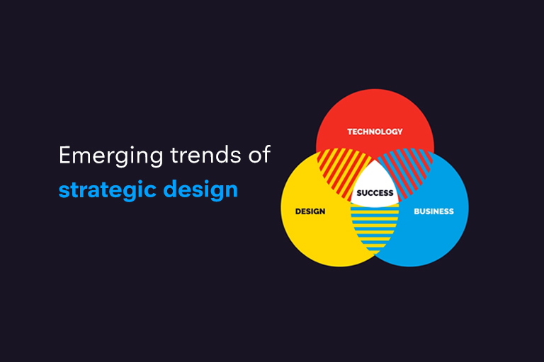

Slide 6
Why ddd?
For the software design and development.

Slide 7
Advantages
If your project… | Points | Supporting Thoughts
If your application is completely data-centric and truly qualifies for a pure CRUD solution, where every operation is basically a simple database query to Create, Read, Update, or Delete, you don’t need DDD. Your team just needs to put a pretty face on a database table editor. In other words, if you could trust your users to just insert data directly into a table, update it, and sometimes delete it, you wouldn’t even need a user interface. That’s not realistic, but conceptually relevant. If you could even use a simple database development tool to create a solution, don’t waste your company’s time and money on DDD. | 0 | This seems like a no-brainer, but it’s not usually that easy to determine simple versus complex. It’s not like every application that isn’t pure CRUD deserves the time and effort of using DDD. So maybe we could come up with other metrics to help us draw a line between what is complex and what is not…
If your system requires just 30 or less business operations, it’s probably pretty simple. This would mean that your application would have no more than 30 total user stories or use case flows, with each of those flows having only minimal business logic. If you could quickly and easily develop such an application using Ruby on Rails or Groovy and Grails and not feel the pain of lacking power and control over complexity and change, your system probably doesn’t need to use DDD. | 1 | To be clear, I am talking 25-30 single business methods, not 25-30 whole service interfaces, each with multiple methods. The latter might be complex.
So let’s say that somewhere in the range of 30 to 40 user stories or use case flows could be creeping toward complexity. Your system might be getting into DDD territory. | 2 | Caveat Emptor: Very often complexity is not recognized soon enough. We software developers are really, really good at underestimating complexity and level of effort. Just because we might want to code up a Rails or Grails application doesn’t mean we should. In the long run those could hurt more than help.
Even if the application is not going to be complex now, will it grow in complexity? You may not know this for sure until real users start working with it, but there is a step under Supporting thoughts that may help uncover the true situation. Be careful here. If there is any hint at all that the application has even moderate complexity—here’s a good time to be paranoid—it may be sufficient indication that it will actually be more than moderately complex. Lean toward DDD. | 3 | Here it pays off to walk through the more complex usage scenarios with domain experts and see where it leads. Are domain experts… (1) already asking for more complex features? If so, it’s likely an indication that the application is already or will soon become too complex to use a CRUD approach. (2) so bored with the features that they can hardly bear discussing them? It’s probably not complex.
The application’s features are going to change often over a number of years, and you can’t anticipate that the kinds of changes will be simple. | 4 | DDD can help you manage the complexity of refactoring your model over time.
You don’t understand the Domain because it’s new. As far as you and your team know, nobody has done this before. That most likely means it’s complex, or at least deserves due diligence with analytical scrutiny to determine the level of complexity. | 5 | You are going to need to work with domain experts and experiment with models to get it right. You certainly also scored on one or more of the previous, so use DDD.

Slide 8
Continued…
One of the goals of DDD is to bring the technical and business aspects of the design process together.
Domain-driven helps ensure clear communication and discussion.
Domain-driven design is an ideal route to a coherent and consistent design process. E.g. a complex and varied business environment; i.e. numerous data sources, various interconnections between data, and multiple outputs.

Slide 9
Ddd for Micro service

Slide 10
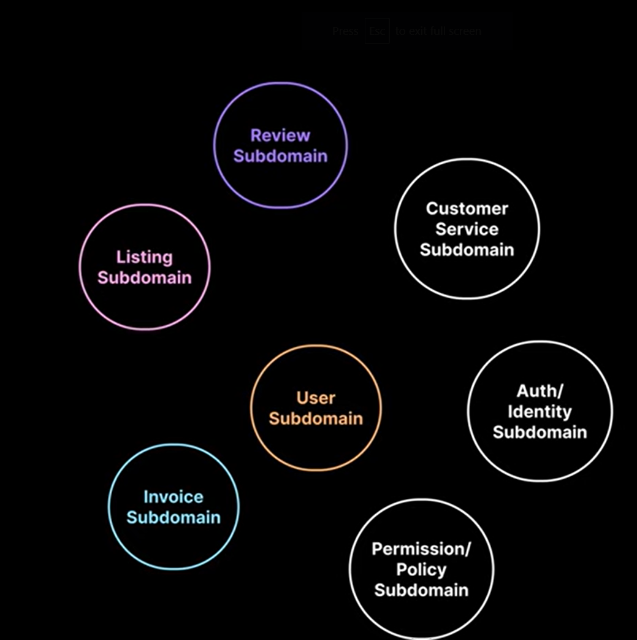
domain driven design micro service

Slide 11
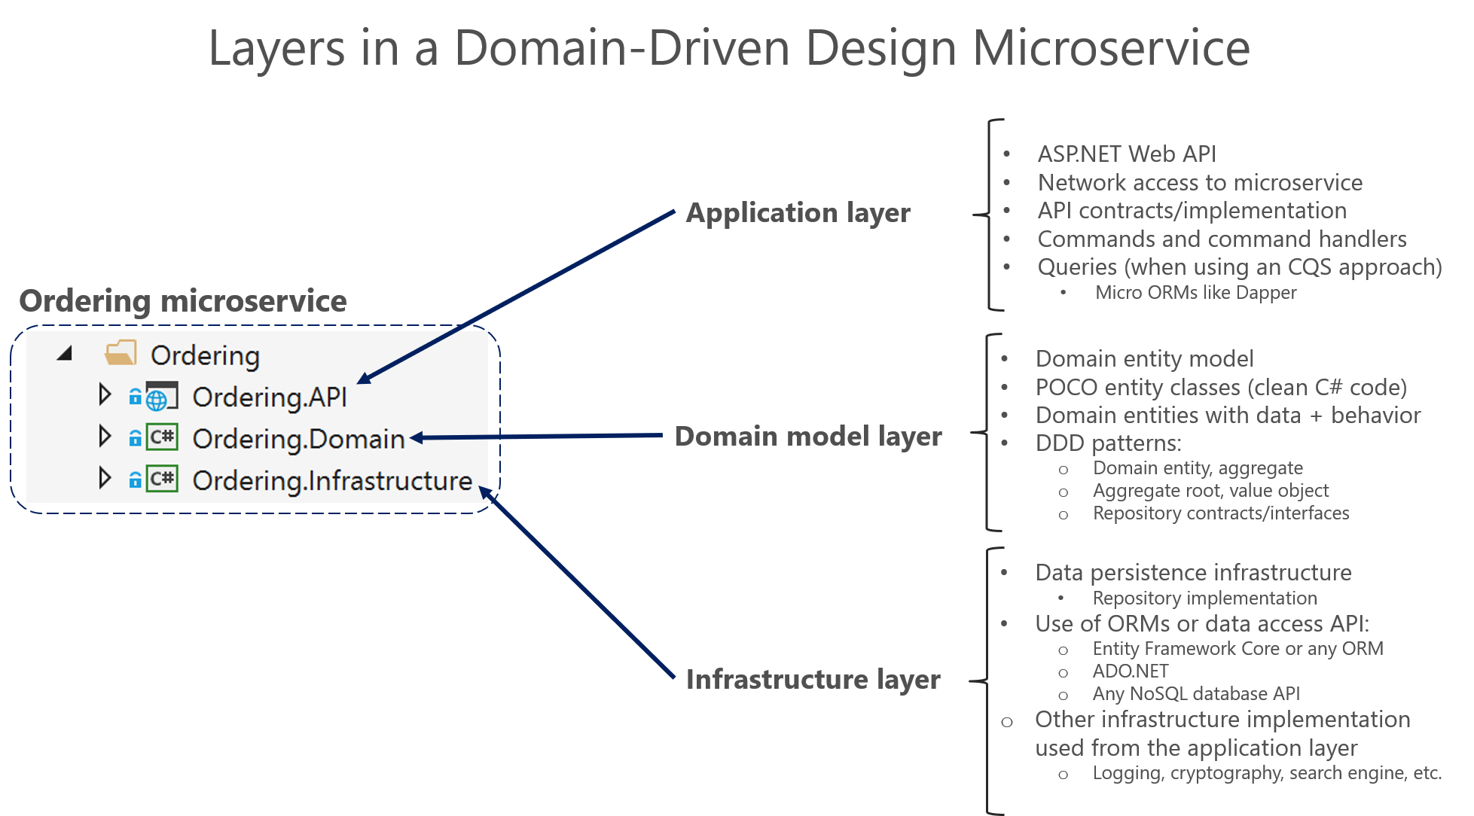

Slide 12
Structure of micro service
DDD approaches should be applied only if you are implementing complex microservices with significant business rules. Simpler responsibilities, like a CRUD service, can be managed with simpler approaches.
You should create a boundary around things that need cohesion. Second, you want to avoid chatty communications between microservices. If two microservices need to collaborate a lot with each other, they should probably be the same microservice.
Each layer communicates only with certain other layers.

Slide 13
Domain model
When you implement a microservice domain model layer in .NET, that layer is coded as a class library with the domain entities that capture data plus behavior (methods with logic).
Data persistence tasks should be performed by the infrastructure layer.
You should not ignore persistence concerns. It is still important to understand the physical data model and how it maps to your entity object model.

Slide 14
application
Defines the jobs the software is supposed to do and directs the expressive domain objects to work out problems.
It does not contain business rules or knowledge, but only coordinates tasks and delegates work to collaborations of domain objects in the next layer down.
It includes queries if using a CQRS approach, commands accepted by the microservice, and even the event-driven communication between microservices (integration events).
It delegates the execution of business rules to the domain model classes themselves (aggregate roots and domain entities), which will ultimately update the data within those domain entities. the implementation related to a Web API service.

Slide 15
infrastructure
How the data that is initially held in domain entities (in memory) is persisted in databases
Entity Framework Core code to implement the Repository pattern classes that use a DBContext to persist data in a relational database.
Dependencies in a DDD Service, the Application layer depends on Domain and Infrastructure, and Infrastructure depends on Domain, but Domain doesn't depend on any layer. This layer design should be independent for each microservice

Slide 16
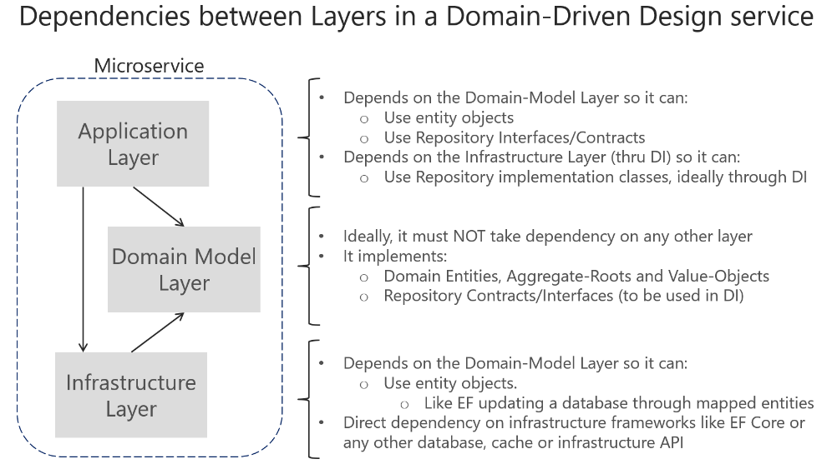

Slide 17
aggregates

Slide 18
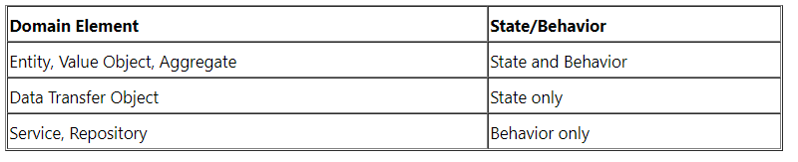
Aggregates
Aggregates are the important components of a DDD implementation. The main role of an aggregate is to enforce consistency and invariants through behaviors and encapsulation. Thus, the flow gets organized around the aggregates (as well as the other entities).
You should note that aggregate roots guard their sub-entities zealously. The biggest rule to keep in mind is that aggregate roots are the only kind of entity to which your software may hold a reference.
Let's assume I have an entity called Policy. Well, policies get renewed on an annual term, so there's likely an entity called Period. Since a Period cannot exist without a Policy and you can act on Periods through Policy, Policy is said to be an aggregate root and Period is a child of the same.

Slide 19
Example of MPM MS

Slide 20
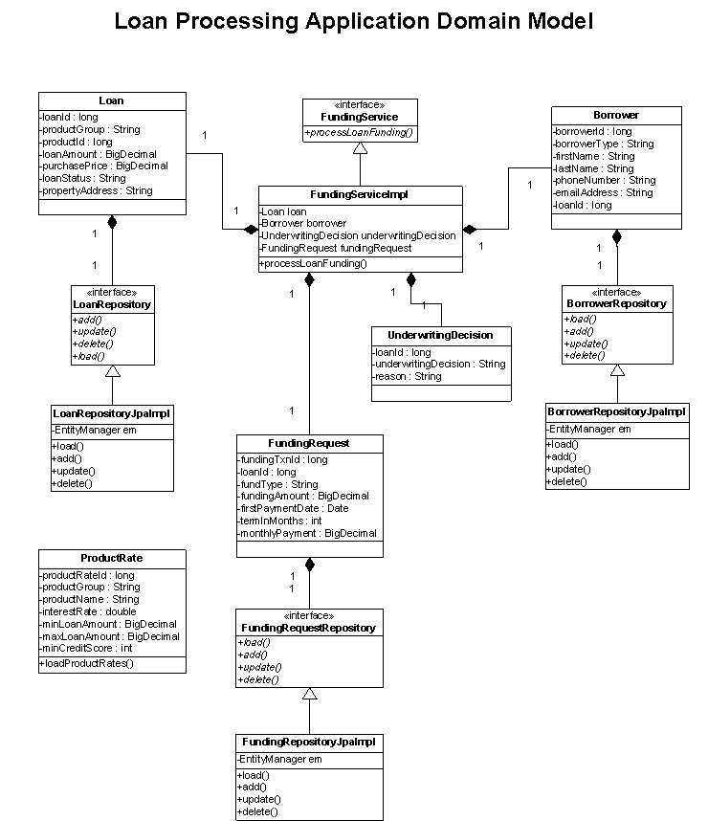
Entities: Loan Borrower UnderwritingDecision FundingRequest Value Objects: ProductRate State Services: FundingService Repositories: LoanRepository BorrowerRepository FundingRepository

Slide 21
Must have with ddd

Slide 22
Dependency injection
DI is a great way to move the configuration and dependency code out of the domain objects. Also, the design dependency of domain classes on Data Access Object (DAO) classes and service classes on domain classes makes DI a "must have" in DDD implementation. DI facilitates a cleaner and loosely coupled design by injecting the other objects such as Repositories and Services into Domain Objects.
Aspect Oriented Programming - AOP helps in an even better design (i.e. less cluttering in the domain model) by removing the cross-cutting concerns code like auditing, domain state change tracking etc from the domain objects.
Annotations - Annotations help in minimizing the required artifacts for implementing the remote services such as EJB or Web Services.

Slide 23
DDD anti patterns

Slide 24
Anti patterns
On the flip side of the best practices and design patterns, there are some DDD smells that architects and developers should watch out for when implementing the domain model. As a result of these anti-patterns, domain layer becomes the least important part in application architecture and facade classes assume a more important role in the model. Following are some of these anti-patterns:
Anemic domain objects - where the domain objects contain little or no business logic like validations, calculations, rules, and so forth. The business logic is thus baked into the architecture of the program itself, making refactoring and maintenance more difficult and time-consuming.
Repetitive DAO's
Fat Service Layer: This is where service classes will end up having all the business logic.
Feature Envy: This is one of the classic smells mentioned in Martin Fowler's book on Refactoring where the methods in a class are far too interested in data belonging to other classes.

Slide 25
Database with DDD

Slide 26
EF core or EF
an entity is an object defined not by its attributes, but its identity. As an example, most airlines assign a unique number to seats on every flight: this is the seat's identity.
In contrast, a value object is an immutable object that contains attributes but has no conceptual identity. When people exchange business cards, for instance, they only care about the information on the card (its attributes) rather than trying to distinguish between each unique card.
Domain-driven design recognizes multiple kinds of models. Models can also define events (something that happened in the past). A domain event is an event that domain experts care about.
Models can be bound together by a root entity to become an aggregate. Objects outside the aggregate are allowed to hold references to the root but not to any other object of the aggregate. The aggregate root checks the consistency of changes in the aggregate. Drivers do not have to individually control each wheel of a car, for instance: they simply drive the car. In this context, a car is an aggregate of several other objects (the engine, the brakes, the headlights, etc.)
A repository, for instance, is an object with methods for retrieving domain objects from a data store (e.g. a database). Similarly, a factory is an object with methods for directly creating domain objects.
domain objects should be defined purely by the business behavior of the domain, rather than by a more specific technology framework.

Slide 27
Relationship with other patterns
Model-driven engineering and architecture
Model-driven architecture is more concerned with translating a model into code for different technology platforms than defining better domain models. Thanks to model-driven engineering's model transformation and code generation techniques, the domain model can be used to generate the actual software system that will manage it.
Command Query Responsibility Segregation
for separating reading data (a 'query') from writing to data (a 'command'). CQRS derives from Command and Query Separation (CQS), coined by Greg Young.
Commands mutate state and are approximately equivalent to method invocation on aggregate roots or entities. Queries read state but do not mutate it. The idea is that a given aggregate root has a method that corresponds to a command and a command handler invokes the method on the aggregate root. The aggregate root is responsible for performing the logic of the operation and yielding either a number of events, a failure response or just mutating its own state that can be written to a data store. The command handler pulls in infrastructure concerns related to saving the aggregate root's state and creating needed contexts (e.g., transactions).
Event sourcing
When event sourcing is combined with CQRS and domain-driven design, aggregate roots are responsible for validating and applying commands (often by having their instance methods invoked from a Command Handler), and then publishing events

Slide 28
conclusion

Slide 29
conclusion
“The essential thing about Domain-Driven Design is that you have to care more about the business or the domain that the software is being targeted at…” - Eric Evans
“The goal of Domain-Driven Design is not to simply produce better software but to enable better business outcomes.” - Scott Millet
Domain-Driven Design is all about business, complex business. Let’s call it Business Driven Design for a moment. A design that is driven by business. A software design that is driven by business experts, business rules and business activities. Not by technical people nor technical point of view. Thus, in return it gives a better output to answer the expectations of business people. So it’s very clear that Domain-Driven Design is an option only when we create business software.

Slide 30
References

